Slide 1


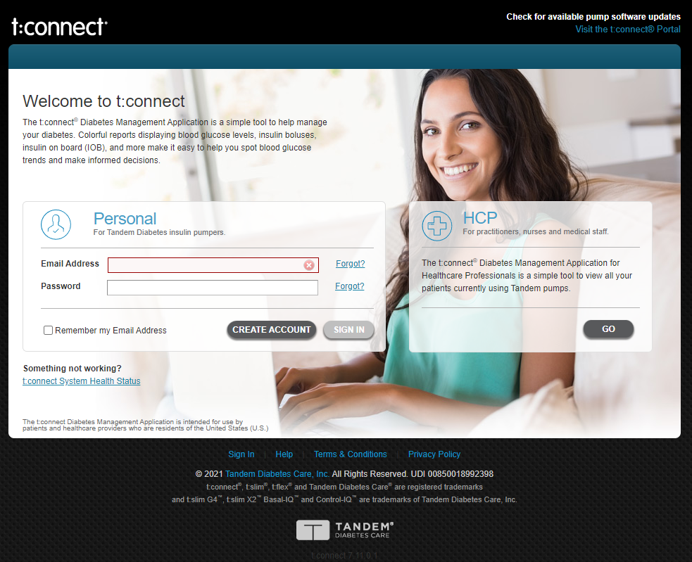

Welcome to Robo-Endo
Robo Endo
Please navigate to:
https://tconnect.tandemdiabetes.com/login.aspx
Next

Slide 2
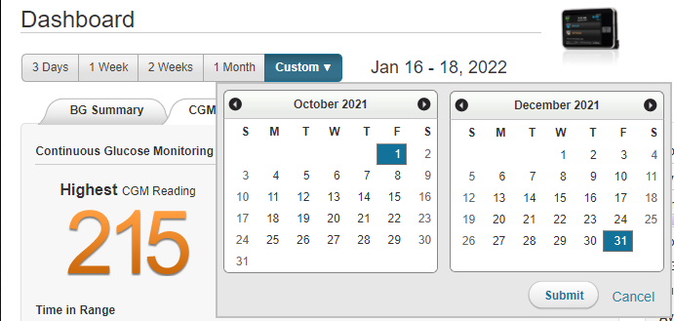
Robo Endo
After your data is uploaded click “Custom” and select a time period of 3 or more months
Back
Next

Slide 3
Robo Endo
Now click “Reports”
Back
Next

Slide 4
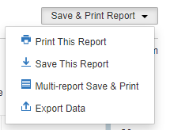
Robo Endo
Under “Save & Print Report” choose “Export Data”
Back
Next

Slide 5

Robo Endo
Now choose that file here
Back

Slide 6
Robo Endo
Loading…
Optional Loading Bar

Slide 7
Robo Endo
Graph 1
Graph 2
Graph 3
Graph 4
Graph 5
Endo Suggestions
New Data

